Slide 1

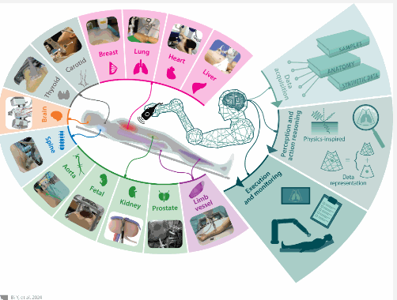
Intelligent Robotic – Ultrasound Imaging
Yuan Bi, Zhongliang Jiang, Felix Duelmer, Dianue Huang, and Nassir Navab
¹ Department of Healthcare
Introduction
Conclusions
In recent decades, autonomous medical robots draw attention to the fundamental sensing systems and AI, the synergy between medical staff and robots have increased.
The benefit of no radiation increased the use of ultrasound robots which is the main reason was diagnose and take pictures. However, the treatment was far behind based on the images that was entail patient and a specific procedure.
Robotic systems have shown the ability of exceed human capabilities in certain area. For instance, enable robots to be operate in conditions that human would not be able to work such as lunar surface and the deep sea. However, we still need humans to orientate those machine because they do not have the capability of thinking and discern what is right or wrong.
The International Organization for Standardization (ISO) and the International Electrotechnical Commission(IEC) had created one rule called (IEC/TR 60601-4-1) to ask safety, clarity and trustworthiness on those medical devices, those device interact with patients without anaesthesia, hence they need to be specialized with the regulations.
Advances on this area made with these robots allows people to better on their field to concentrate with things that really matter which is saving lives because some of the error that was made by a professional was, they were tired or made a call base in information they did not have.
Some negatives impacts could be the one with full autonomy take one case in specific and evaluate the best treatment base on that which could been wrong because every situation should be based on the diagnostic that patient had. Another case is the drone that being used to deploy bomb in some areas.
This paper showed the relevance of those machines in our lives which brought so many advances in different fields and giving the opportunity to improve our healthcare system.
Those machines are super precise, but we need to train the people that operate because we have seen some cases of negligence and error on diagnose.
Modern Robotic systems and control method still must progress towards understating the physiological aspects of human tissues and diseases.
Those machines have helped save a lot of lives and will be the future to reduce errors that could cost their lives.
We conclude that so many advances was made with the use of those machines, but we still must make sure we program them to evaluate all the aspects and never decide without consulting a specialist on the field.
Methods
To produce high-quality ultrasound images which is essential for diagnosis and analysis, robotic ultrasound systems should be able to target areas with precision and regulating some features. These features include firstly by contact, positions and orientation. After those advances made with the inclusion of the robotic ultrasound system it was clear that the imaging, control accuracy and execution safety would be more beneficial for the patient and consequently for the medical procedures.
Results
Ethics and regulations must be implemented because of the increasement of robotics systems which ask for a clear definition of responsibility. According to Yang GZ, he had defined six levels of autonomy: no autonomy, robot assistance, task autonomy, conditional autonomy, high autonomy, and full autonomy. The da Vinci robot its one the most successful robot on the field.
Fig. 1 Robotic ultrasound imaging systems
References
https://www.annualreviews.org/content/journals/10.1146/annurev-control-091523-100042#right-ref-B2
Our Dedication.Your Journey.
www.cct.ie

